Slide 1
Thursday, March 27 1-3 pm EST
National Telecommunications and Information Administration (NTIA) Webinar
Metrics for Research & Evaluation of
BTOP and Beyond
Kate Williams University of Illinois

Slide 2
Unit of analysis: What are you interested in?
Sustainability … of …
Broadband?
Projects?
Individuals?
Community!

Slide 3
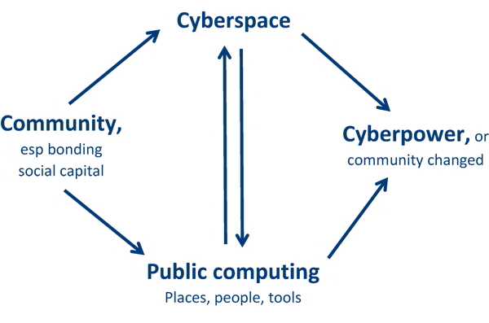
We use a MODEL that identifies four parts to community sustainability
C_{t=1} C_{t=2}
(The Illinois Model)

Slide 4
Our core concepts, our findings
Community (local), social capital (shared resources):
Community technology adoption and transformation rely primarily on forces within that community, even in underresourced communities
Public computing
These spaces are highly useful for local community members
What makes these spaces work well
Cyberpower (wielding power in cyberspace)
What results do communities get from using technology
Informatics moment (when someone bridges their own digital divide, usually with help)
Successful technology use is a process of self-reliant community transformation

Slide 5
Then, what’s the unit of observation? How many cases will you study?
Community
Community organizations
Libraries
Public computing places
Other types of agencies
Grassroots volunteer-driven, or not
For profit, public, and/or non-profit
Technology oriented, e.g. broadband providers
Virtual, for instance localwiki.org
More basic community organization:
Families
Dyads
The individual
…or perhaps the relationships between these!

Slide 6
Our findings—confirmed by the American Library Association—are that public computing is an indicator of a community that is sustainable in the digital age. So let’s take that as our dependent variable…

Slide 7
So we’d focus on this portion of reality:

Slide 8
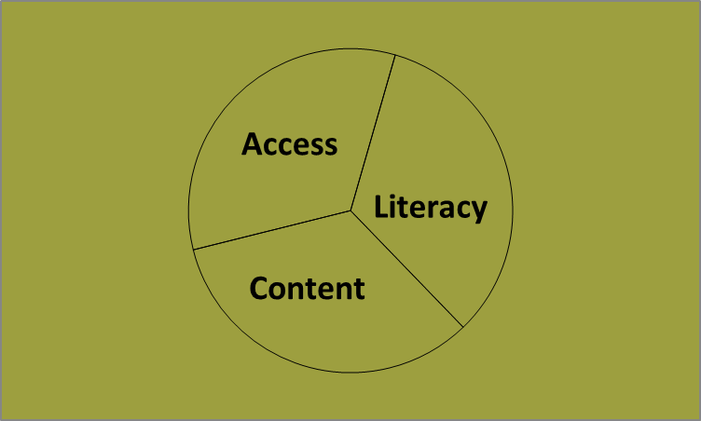
Public computing has 3 parts
(Seattle Community Technology Dept)

Slide 9
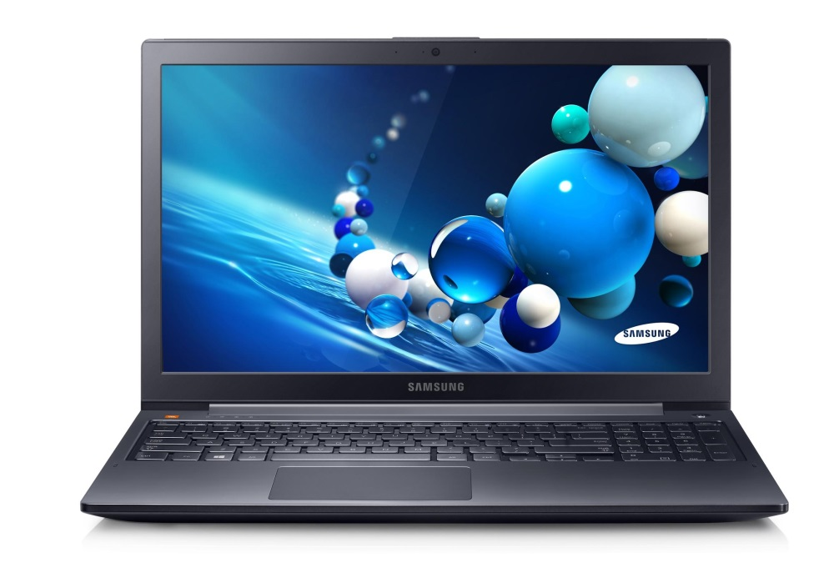
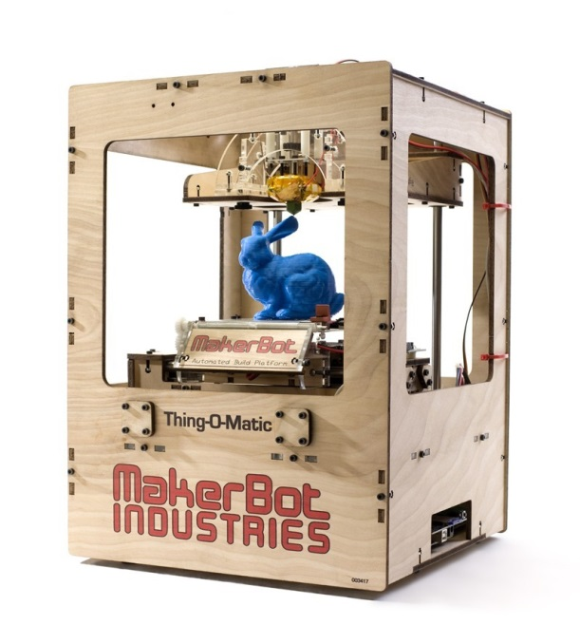
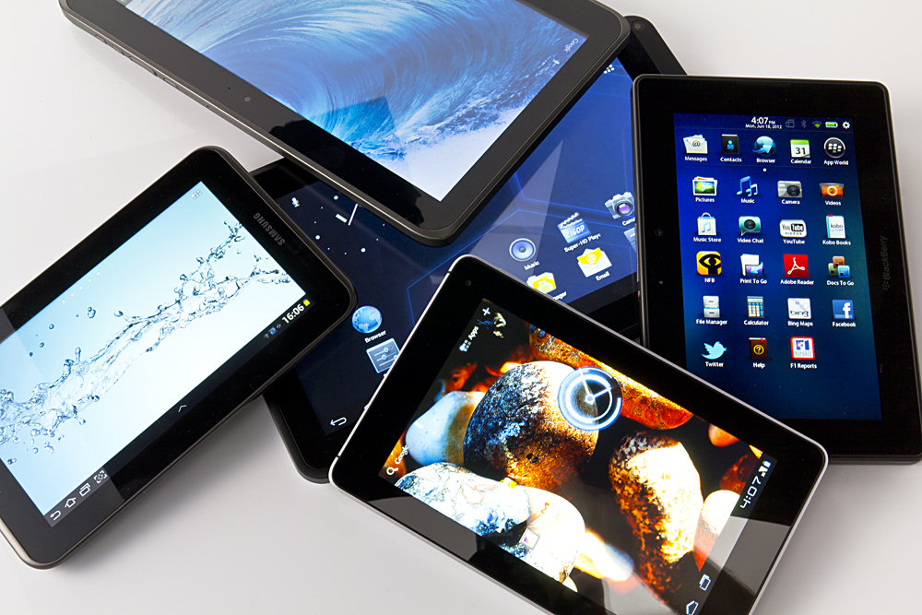
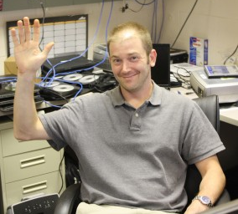
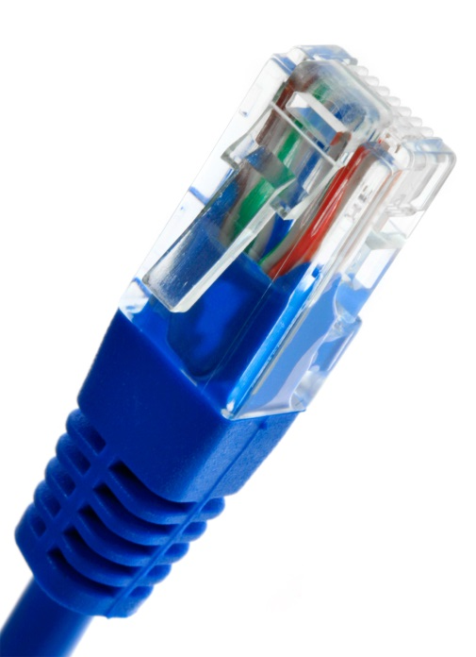
1. ACCESS = Machines + Internet + IT support

Slide 10
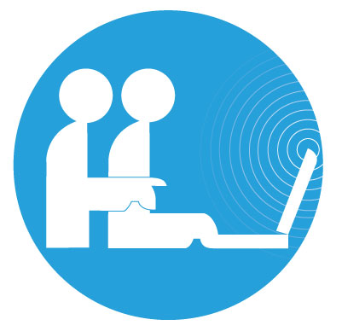
2. LITERACY = Skills, yes, plus cybernavigators (or tech volunteers) + community organizing
For comics and logo, search the web for ‘Cybernavigator Stories’

Slide 11
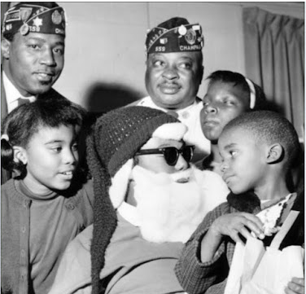
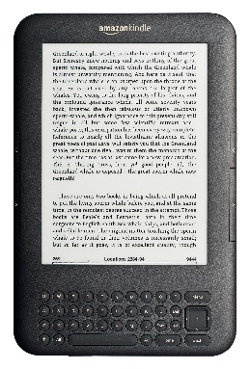
3. CONTENT = Email + Job hunting + Photos + Video + Local & Family history + Wikis + Health + eBooks…

Slide 12
Metrics are a mapping from concepts to measurements …your metrics may differ
From the highest abstractions ↓ Sometimes through some intermediate abstractions
↓ To some concrete and measurable phenomenon

Slide 13
From big concepts to measurements
Access
Machines
Internet
IT support
Literacy
Skills
Cybernavigators
Community organizing
Content
Many types
Many examples
…
Software, hardware, #s?
Speed, cost?
How many, how nearby?
…
Common queries?
How many, how nearby?
Programs and people? BTOP and others?
…
Local wiki? Wikipedia?
Ancestry? Find-A-Grave?

Slide 14
Then, what aspects of the community support or inhibit that public computing? [independent variable]
Who’s involved (.org, .gov, .com, .edu)
Who’s involved (community members)
What did they do?
What was there before? maybe a TOP project!
Community
Community organizations
Libraries
Public computing places
Other types of agencies
Grassroots volunteer-driven, or not
For profit, public, and/or non-profit
Technology oriented, e.g. broadband providers
Virtual, for instance localwiki.org
More basic community organization:
Families
Dyads
The individual
…or perhaps the relationships between these!

Slide 15
Thanks for listening
Feedback welcome :-)
Kate Williams
katewill@illinois.edu
URL:
go.illinois.edu/katewill

