Slide 1
Saturday, March 15 9:15-10:15 am
PLA ConverStation:
Powerful Public Computing Programs with Low-To-No Budgets
Kate Williams and Noah Lenstra

Slide 2
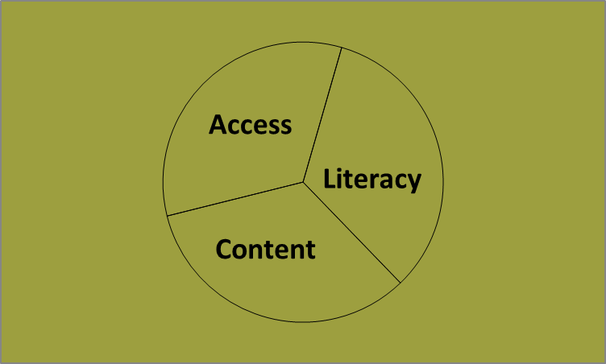
Include ALL THREE PARTS of public computing

Slide 3
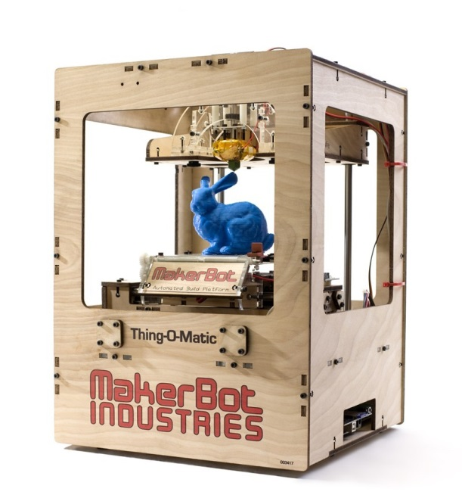
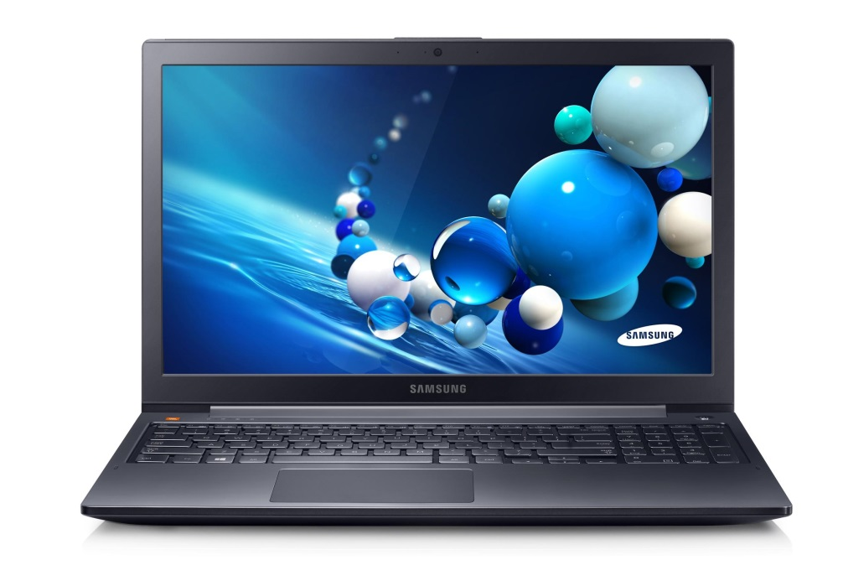
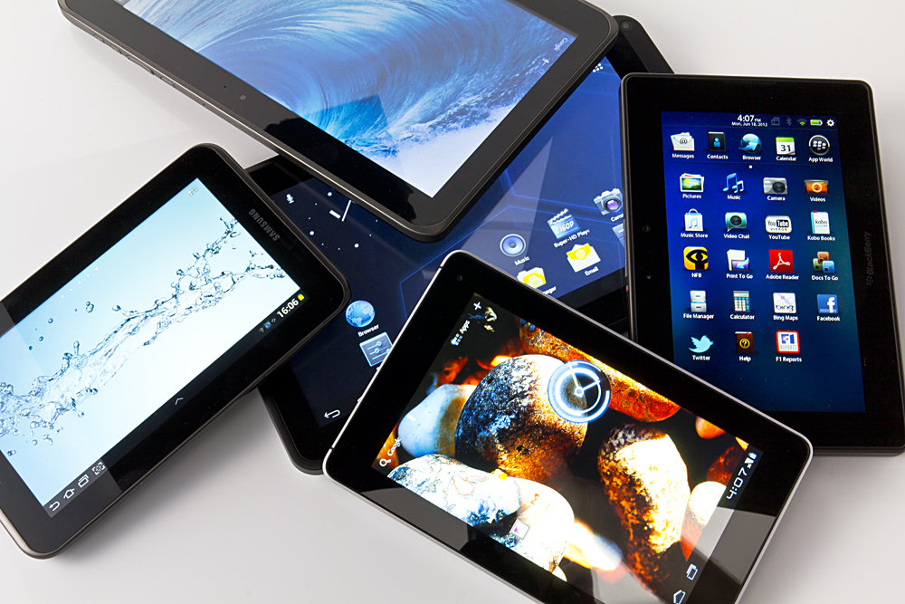
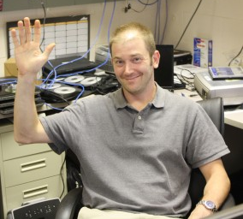
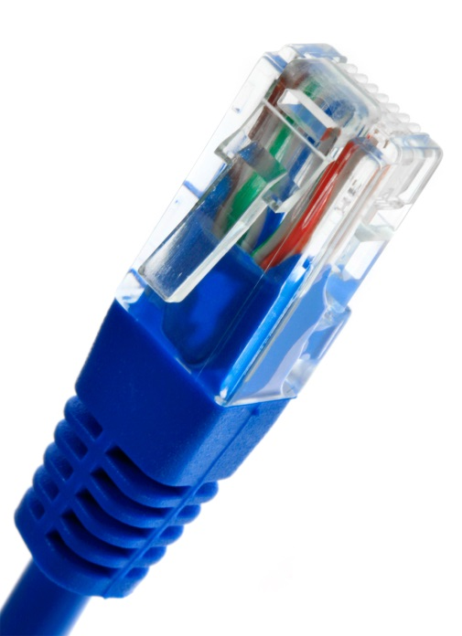
1. ACCESS = Machines + Internet + IT support

Slide 4
Conversate: Access
What’s your name? Your town?
What’s your library’s access?
What are the current issues?

Slide 5
2. LITERACY = Cybernavigators (or tech volunteers) + community organizing
For comics and logo, search on Cybernavigator Stories

Slide 6
Conversate: Literacy
Could any of this work for you?
How would you adapt it?
What else do you do?
What else could you do?

Slide 7
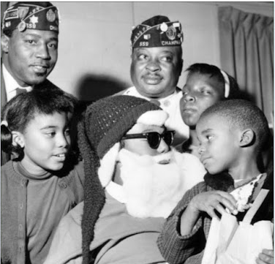
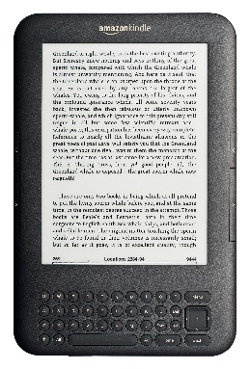
3. CONTENT = Email + Job hunting + Photos + Video + Local & Family history + Wikis + Health + eBooks…

Slide 8
Conversate: Content
Could any of this work for you?
How would you adapt it?
What else do you do?
What else could you do?

Slide 9
Thanks for sharing!
And thanks for your feedback :-)
Kate Williams & Noah Lenstra
katewill@illinois.edu, nlenstr2@illinois.edu

